Slide 1
Quantity, Quality and Distribution
Mirko Farina
Assistant Professor
Innopolis University
* I do not claim authorship for all texts and pictures in the presentation.

Slide 2
Summary of Previous Lecture + Exercises
Quantity
Quality
Distribution
Exercises
2

Slide 3

Summary of Previous Lecture, in a nutshell
Categorical Logic was developed by Aristotle
-Presented in the Organon
-Two crucial notions underlying it: syllogism and term*
-Gets us to basic through via deductive means
-It represents an alternative to other Logical Systems developed in ancient time (Stoic Logic), which we lost
*A categorical proposition is a proposition that relates two classes of objects
Categorical propositions contain a subject and a predicate term.
Categorical propositions also contain a copula and quantifiers
3

Slide 4
WHY IS IT IMPORTANT?
In this logic, we can say something about all members of a class, called a universal sentence, or we can say something about some members of a class, called a particular sentence.
We can also make a positive claim, called an affirmation, or we can make a negative claim, called a negation
The way we do this is through standard categorical statements
4

Slide 5
All S are P
2. No S are P
3. Some S are P
4. Some S are not P
5

Slide 6
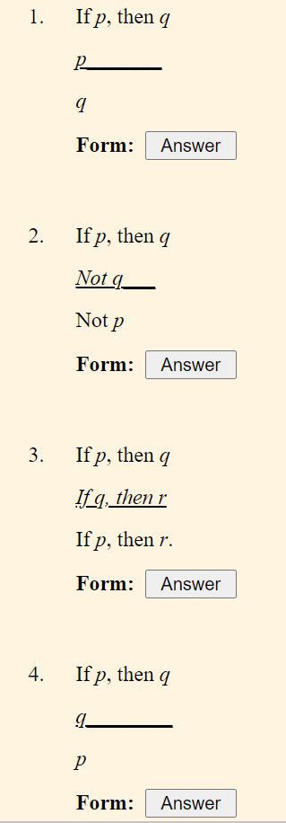








6

Slide 7
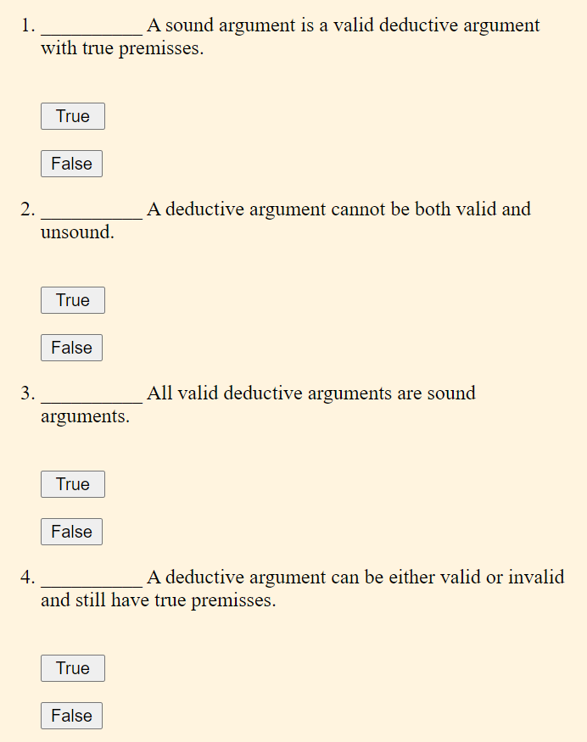
7

Slide 8
5. When the premisses of a deductive argument are true, the conclusion is always true as well
?
8

Slide 9
2. Quantity – how much?
The QUANTITY of a proposition is either universal or particular.
A proposition is UNIVERSAL if its quantifier is ALL or NO.
A proposition is particular if its quantifier is SOME.
9

Slide 10










All S are P
2. No S are P
3. Some S are P
4. Some S are not P
10

Slide 11


3. Quality – in which way?
In what way Are the classes being related?
Affirmative – something is the case
Claim about existence, all the members of one class are related to the members of the second class in a positive sense
Example: all humans are mammals; all mice are rodents
Negative - something is not the case
out of all the class of the first class none of them are members of the second class – they are excluded
Example: No dogs are fishes; no mice are rodents
11

Slide 12
The QUALITY of a proposition is either affirmative or negative.
A proposition is NEGATIVE if the quantifier is NO or the copula is ARE NOT.
A proposition is AFFIRMATIVE if it is not negative, therefore if the quantifier is ALL or the copula is ARE
12

Slide 13






All S are P
2. No S are P
3. Some S are P
4. Some S are not P
10

Slide 14


Porphyry’s Isagoge
b. Boethius’ On the Categorical Syllogism
c. Abelard’s Dialectica
d. Richard of Campsall’ Questions on the Books of the Prior Analytics
e. William of Ockham’s Compendium of Logic
FOUR BASIC FORMS: (next lesson we look at how they are related)!
14

Slide 15
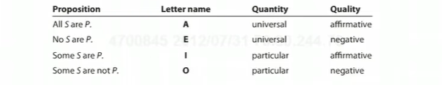





Summing up:
15

Slide 16














EXERCISE
Identify the form of the categorical statements expressed by the following sentences.
All heroes are brave people.
No brave people flee from danger.
Some people who face danger are brave.
Some who flee from danger are not brave.
Philosophers have all studied logic.
Many pre-law students study logic.
There haven't been any philosophers on the moon.
16

Slide 17
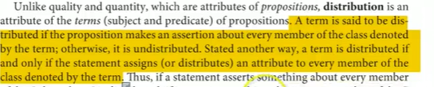



4. Distribution
17

Slide 18
A term is DISTRIBUTED if the proposition applies to everything described by the term
1 to 1 correspondence between subject and predicate terms
In other words, if every member of a class gets related to the other class
18

Slide 19















The A proposition [All S are P] says that every member of the subject class is a member of the predicate class.
Example: All dogs are animals
19

Slide 20





But is reference being made to every member of the predicate class?
NO.
Example: "All artists are eccentric."
You are only saying that if a person is an artist, he is a member of the class of eccentric people (which includes, but goes beyond artists; philosophers are eccentric too!).
20

Slide 21













The E proposition [No S are P] makes reference in a negative way to every member of the subject class. E propositions also assert that not a single member of the S class is a member of the P class, and thus the reference is to the whole of the predicate class.
Example:
no cats are dogs,
no dogs are fishes
21

Slide 22






In the I proposition [some S are P] the quantifier [some] makes it clear that only some members of the subject class are being referred to, so the subject is undistributed (Some S … ).
What about the predicate class?
It is also undistributed because reference is being made to only some of the members of that class not the whole of it.
Example: some men are wealthy
22

Slide 23




In the O proposition [Some S are not P] the quantifier "some" shows that the reference is being made to only some of the subject class (Some S …).
What about the predicate class?
It is distributed, because to say that Some S is not P, we have to know the sum total of the P class to make this assertion.
Examples:
Some registered voters are not property owners.
Some people are not happy
23

Slide 24
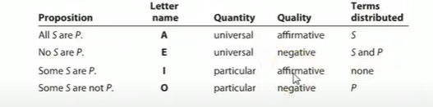

SUMMARY
24

Slide 25
WHAT WE LEARNED TODAY?
STANDARD CATEGORICAL STATEMENTS
QUANTITY (UNIVERSAL, PARTICULAR) QUALITY (AFFIRMATIVE, NEGATIVE: EXCLUSION , INCLUSION)
DISTRIBUTION
25

Slide 26















5. Exercises
Represent these statements with Venn Diagrams
1.All bananas are fruits
2.No bananas are fruits
3.Some bananas are fruits
4. Some bananas are not fruits
5. [if something is a golden retriever, then it is a dog]
Name the quality and quantity of each of the following propositions, and state
whether their subject and predicate terms are distributed or undistributed.
Use diagrams to represent the situation
6.No vampire movies are films without blood
7. Some Chinese leaders are not thoroughgoing opponents of capitalist
economics.
8.Some hospitals are organizations that overcharge the Medicare program.
26

Slide 27













28

Slide 28













29

Slide 29














30

Slide 30





WHICH TERMS ARE DISTRIBUTED? These examples need rephrasing….
9. US presidents are always men.
10. Robins are not mammals.
11. Every jazz fan loves Thelonious Monk.
12. Some Sherlock Holmes fans love Adrian Monk.
13. No one who eats sashimi is vegetarian.
14. Philosophers who write novels are famous.
27

Slide 31




















































EXERCISES 9-14
32

